Slide 1
import this: building your first python package
Luke Keating Hughes 27/10/2020

Slide 2




import this: building your first python package
An overview of today

Slide 3
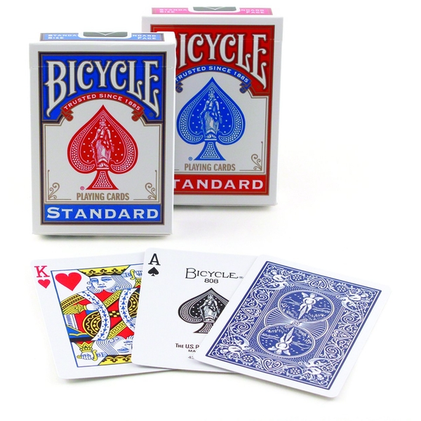
import this: building your first python package
An overview of today

Slide 4
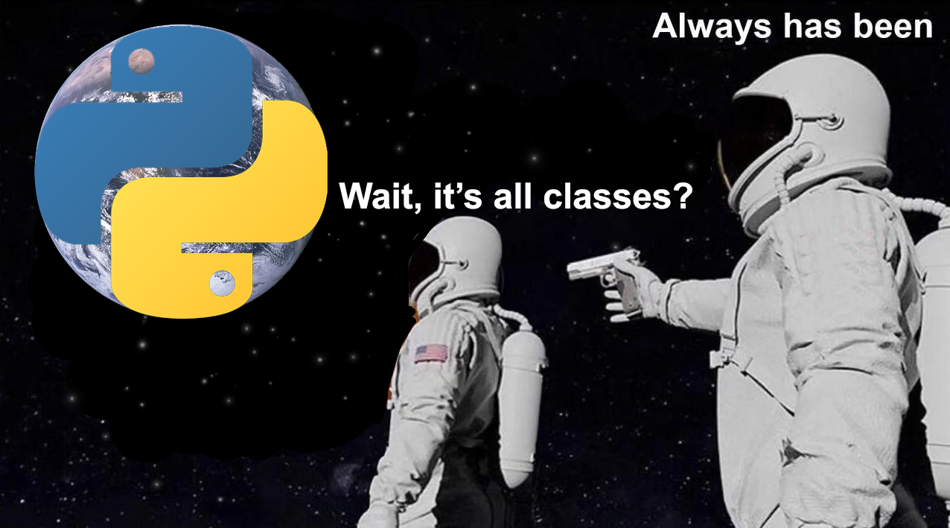
import this: building your first python package
An overview of today

Slide 5
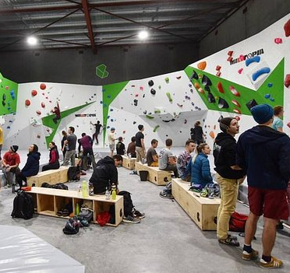




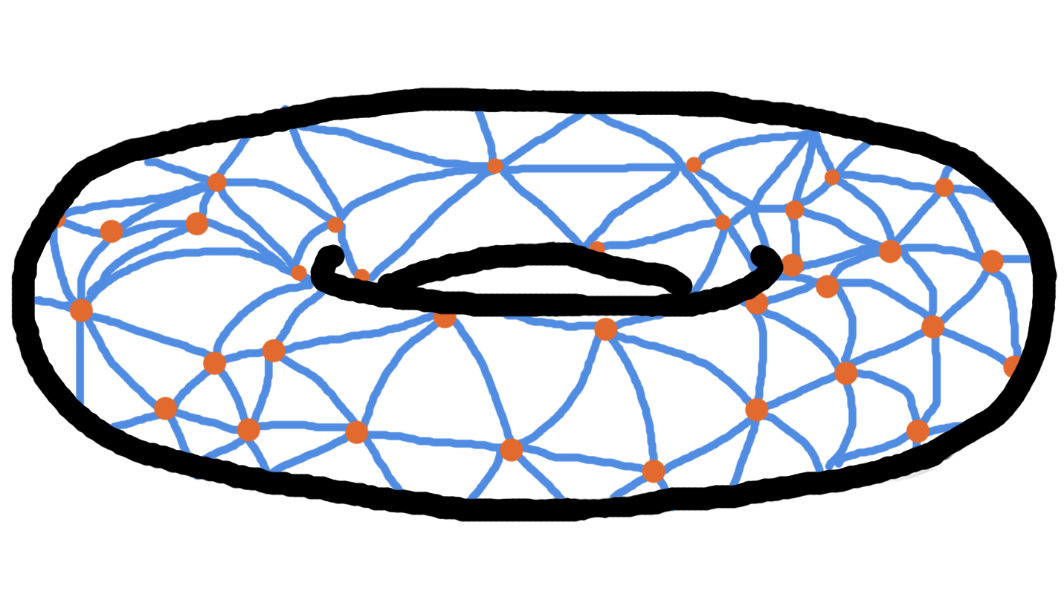
A little bit about me

Slide 6
Experience
(Why you shouldn’t be listening to me)
Started at Capgemini
Started learning python
Started at SvA
First exposure to OOP
Made my second package
Made my first “package”
Now
March 2019
April 2019
May 2019
October 2019
Dec 2019
April 2020
October 2020
time
(not to scale)
Please correct me on explanations, add extra context and butt in for questions!
There are people in the audience who have far more experience than me!

Slide 7
A little bit about the audience
Icebreaker
Could we go around the room and introduce ourselves by saying:
Your name,
Your preferred pronouns (he/she/they),
How often you use python,
One thing they would like to understand better about python. (e.g. what’s with the underscores?)

Slide 8
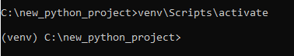
First things first
Set up our project
Firstly, create a git project:
Choose a git host (I’m going to choose GitHub)
Create a very basic readme
Choose a licence (I’m going to choose the MIT licence)
Pull git project into my local
Secondly, set up a virtual environment:
This is a very good idea for any new python project and it will help you understand the minimum requirements that your new project will require for other machines.

Slide 9
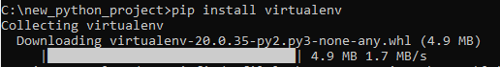
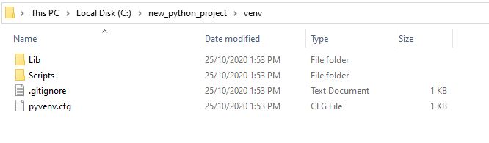
Virtual environment
A little bit more context for those new to virtual environments
[Visit https://docs.python-guide.org/dev/virtualenvs/ for more information]

Slide 10
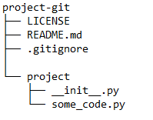
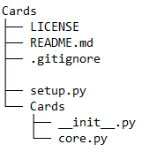
A quick note on package architecture
So we can get started with the coding
Note: The __init__.py file will allow us to call Cards as a module rather than as a folder containing scripts

Slide 11
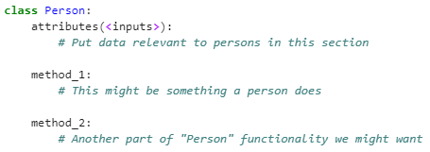
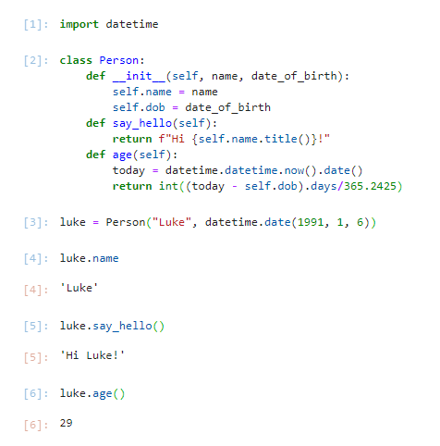
Introduction to python classes
For those with no background

Slide 12
Introduction to python classes
For those with no background
attributes go into __init__

Slide 13
Brainstorming classes and objects
Activity
Task: Break into two groups and brainstorm some objects a deck of cards has on a whiteboard for 5 minutes and some classes that will be our blueprint.
Example: Every deck of cards has an ace of spades object.
After the 5 minutes, we will have a short discussion about what objects we need and then code them up.

Slide 14
Brainstorming attributes
Activity
Task: Break into a group for each class we came up with. In your groups brainstorm the attributes each class will need for 5 minutes.
Example: Every Deck object contains 52 playing cards.
After the 5 minutes, we will have a short discussion about what attributes each group thinks their object will need and then code them up.

Slide 15
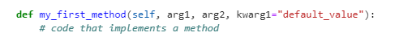
Methods
The functions of classes
A method in a class is just a function that is called from inside of a class.
They follow exactly the same rules as regular old functions in python, except for one detail. An object will always pass itself into the method as the first argument.
This means we can have many instances of the same class without having to worry about accessing the right attributes of the right instance of our class.
By convention we will use “self” to refer to the instance of the class.
Here’s Guido Van Rossum’s blog post on the usage of self if you’d like to know more:
https://neopythonic.blogspot.com/2008/10/why-explicit-self-has-to-stay.html

Slide 16
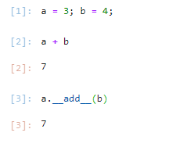
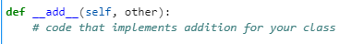
Magic Methods
Why python classes makes your code beautiful
Because everything in python is a class, almost every operation (like print, addition, less than, etc.) can be tailored for our classes.
In python, when you add two integers together, it calls the __add__
magic method. If you create a new class, you can implement your own
way of adding your classes together.

Slide 17
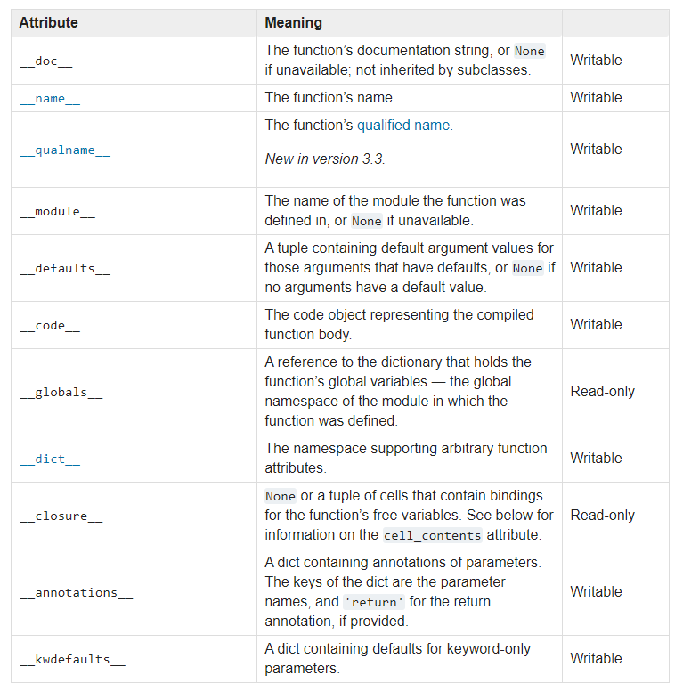
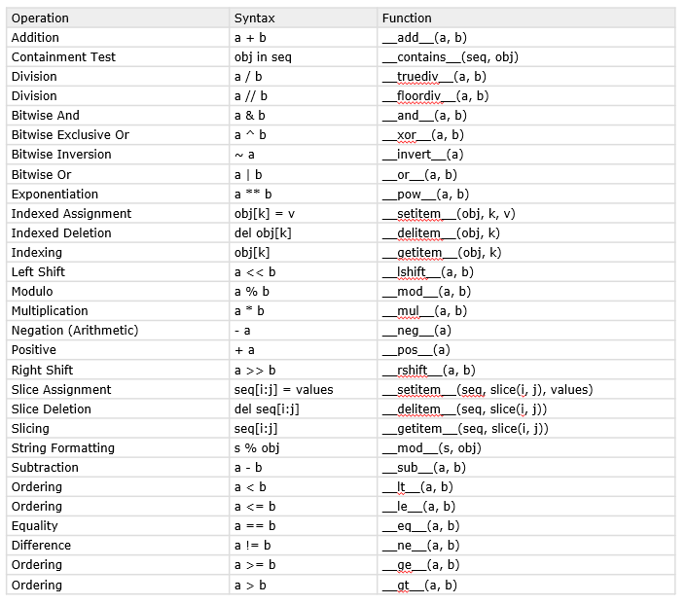
Magic Methods
Why python classes makes your code beautiful
Here are a list of some of the magic methods that can be defined within a class.
Operation | Syntax | Function
Addition | a + b | __add__(a, b)
Containment Test | obj in seq | __contains__(seq, obj)
Division | a / b | __truediv__(a, b)
Division | a // b | __floordiv__(a, b)
Bitwise And | a & b | __and__(a, b)
Bitwise Exclusive Or | a ^ b | __xor__(a, b)
Bitwise Inversion | ~ a | __invert__(a)
Bitwise Or | a | b | __or__(a, b)
Exponentiation | a ** b | __pow__(a, b)
Indexed Assignment | obj[k] = v | __setitem__(obj, k, v)
Indexed Deletion | del obj[k] | __delitem__(obj, k)
Indexing | obj[k] | __getitem__(obj, k)
Left Shift | a << b | __lshift__(a, b)
Modulo | a % b | __mod__(a, b)
Multiplication | a * b | __mul__(a, b)
Negation (Arithmetic) | - a | __neg__(a)
Positive | + a | __pos__(a)
Right Shift | a >> b | __rshift__(a, b)
Slice Assignment | seq[i:j] = values | __setitem__(seq, slice(i, j), values)
Slice Deletion | del seq[i:j] | __delitem__(seq, slice(i, j))
Slicing | seq[i:j] | __getitem__(seq, slice(i, j))
String Formatting | s % obj | __mod__(s, obj)
Subtraction | a - b | __sub__(a, b)
Ordering | a < b | __lt__(a, b)
Ordering | a <= b | __le__(a, b)
Equality | a == b | __eq__(a, b)
Difference | a != b | __ne__(a, b)
Ordering | a >= b | __ge__(a, b)
Ordering | a > b | __gt__(a, b)

Slide 18
Brainstorming magic methods
Activity
Task: Together we will brainstorm on a whiteboard what magic methods we will want in order to code for playing a game of cards for 15 minutes.
Example: A card should implement __str__ so that it prints to screen nicely.

Slide 19
Brainstorming methods
Activity
Task: Split into as many groups as there are classes. In groups, brainstorm methods we will want in order to code for playing a game of cards for 5 minutes.
Example: A Hand object should implement a suit method to return cards of that suit.

Slide 20
Creating your own package
Why python classes makes your code beautiful
Because everything in python is a class, almost every operation (like print, addition, less than, etc.) can be tailored for our classes.
In python, when you add two integers together, it calls the __add__
magic method. If you create a new class, you can implement your own
way of adding your classes together.

Slide 21
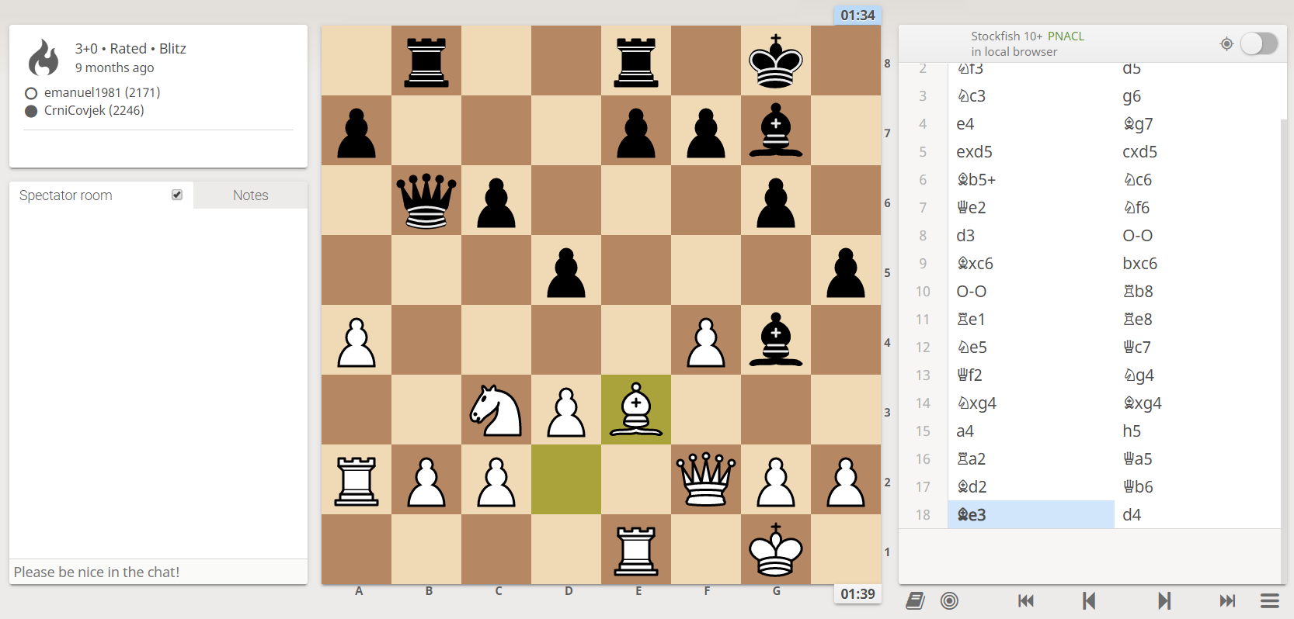
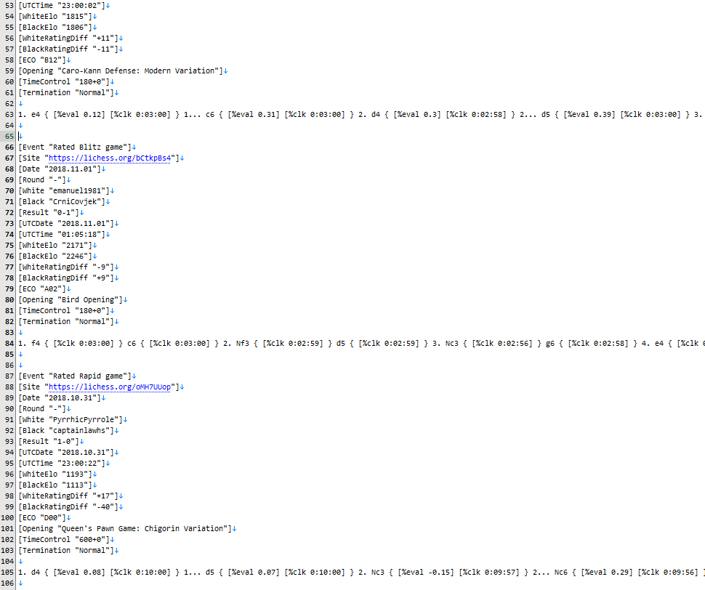
PGN
No, they aren’t pictures
Notes:
Description of pgn and lichess data
Description of how unstructured the data is
- varying headers
- different game notation (i.e. comments, numbering of moves)
- different types of games
I should have heeded Sam’s warning…
Why I chose the data
- challenging
- teach me skills relevant to starting at DHS
- The chess data had perfect integrity. I knew any mistakes I made were mine which is better than most data.

Slide 22
PGN
A standardised notation without structure
[header1: “data”]
[header2: “more data”]
…
1. e4 e5 2. Nf3 Nc6 3…
Notes:
Here is an example of

Slide 23
Hey now, you’re an all Star (Schema)
A standardised notation without structure
[header1: “data”]
[header2: “more data”]
…
1. e4 e5 2. Nf3 Nc6 3…
[header2: “data”]
[header1: “more data”]
…
1. e4 {[%clk = 1:00] [%eval = +0.2]} 1… a1? {[%clk = 0:56] [%eval = +1.2]} 2. …
Notes:
I had to set design considerations from really early in the project. I opted to create a 3NF compliant database with two tables:
- one with all the metadata for each game
- one with all the move data for each game (move no, move, time, eval)
This was a risk and it would have been really hard to go back and change this structure
One regret was creating an index number when there was a perfectly good index in the data already.

Slide 24



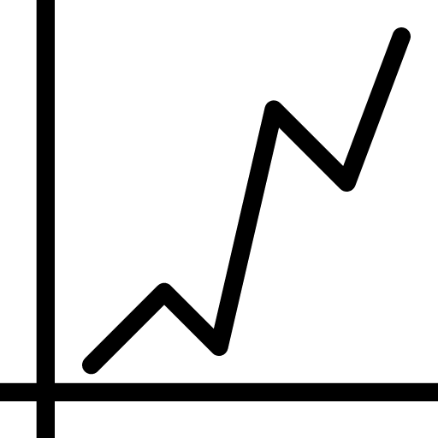



Scope and hypothesis
Following in the footsteps of David Hilbert
?
Notes:
Luckily I had 3 really smart people on the bench with heaps of experience in all of these things: - Sam: PhD in Computer Science
- Paul: BI wiz
- Simon: Lots of industry experience in coding
They encouraged me to stop entertaining hypotheticals and just

Slide 25
Less is more
Simplifying simply simplifies

Slide 26
Hey now, you’re an all Star (Schema)
From unstructured to structure
Notes:
I had to set design considerations from really early in the project. I opted to create a 3NF compliant database with two tables:
- one with all the metadata for each game
- one with all the move data for each game (move no, move, time, eval)
This was a risk and it would have been really hard to go back and change this structure
One regret was creating an index number when there was a perfectly good index in the data already.

Slide 27
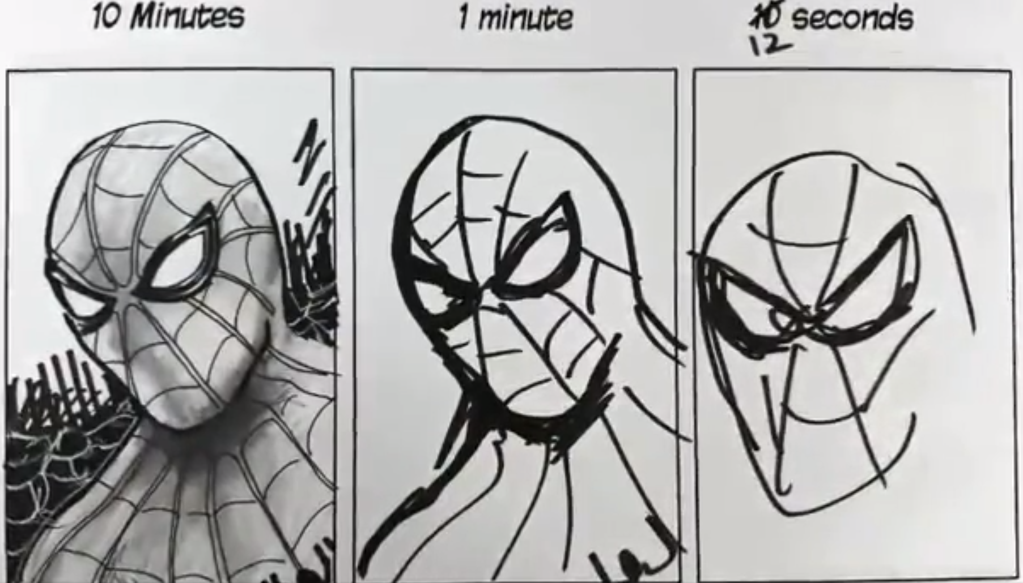
Iterating towards perfection
I’m not bad at coding, I’m agile!
Notes:
v1: Just read and printed pgn line by line, had no idea whether the headers were correct, etc, very error prone
v2: Started to be more careful, checked headers were right and discarded games that didn’t conform. Way better for pulling data out but still losing lots of games that could have been salvaged
v3: Main code just identifies blocks and passes them to functions to do all the specialized processing. Code is modular and easy to upgrade if a bug/new type of game is spotted. Functions became sophisticated enough to salvage information from games that didn’t conform to the normal structure. Began logging games that caused strange problems.
v4: No games are missed. Functions are now using chess packages to enrich the data before passing it to database (i.e. tracking locations of pieces in a third table).
Lesson learnt after working at DHS: use Git!!!

Slide 28
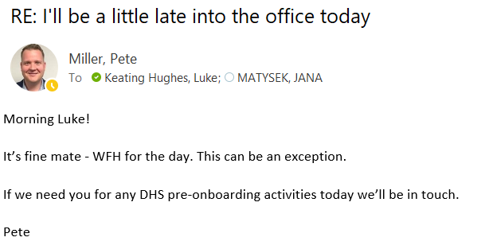
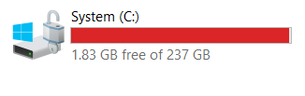
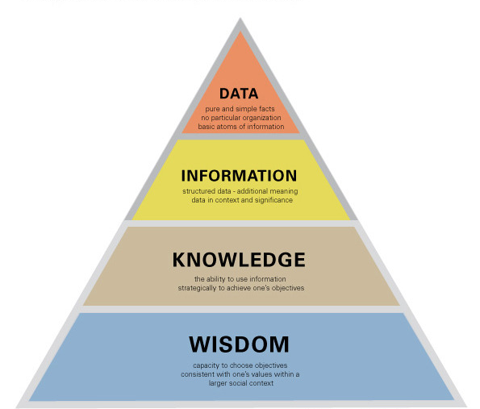

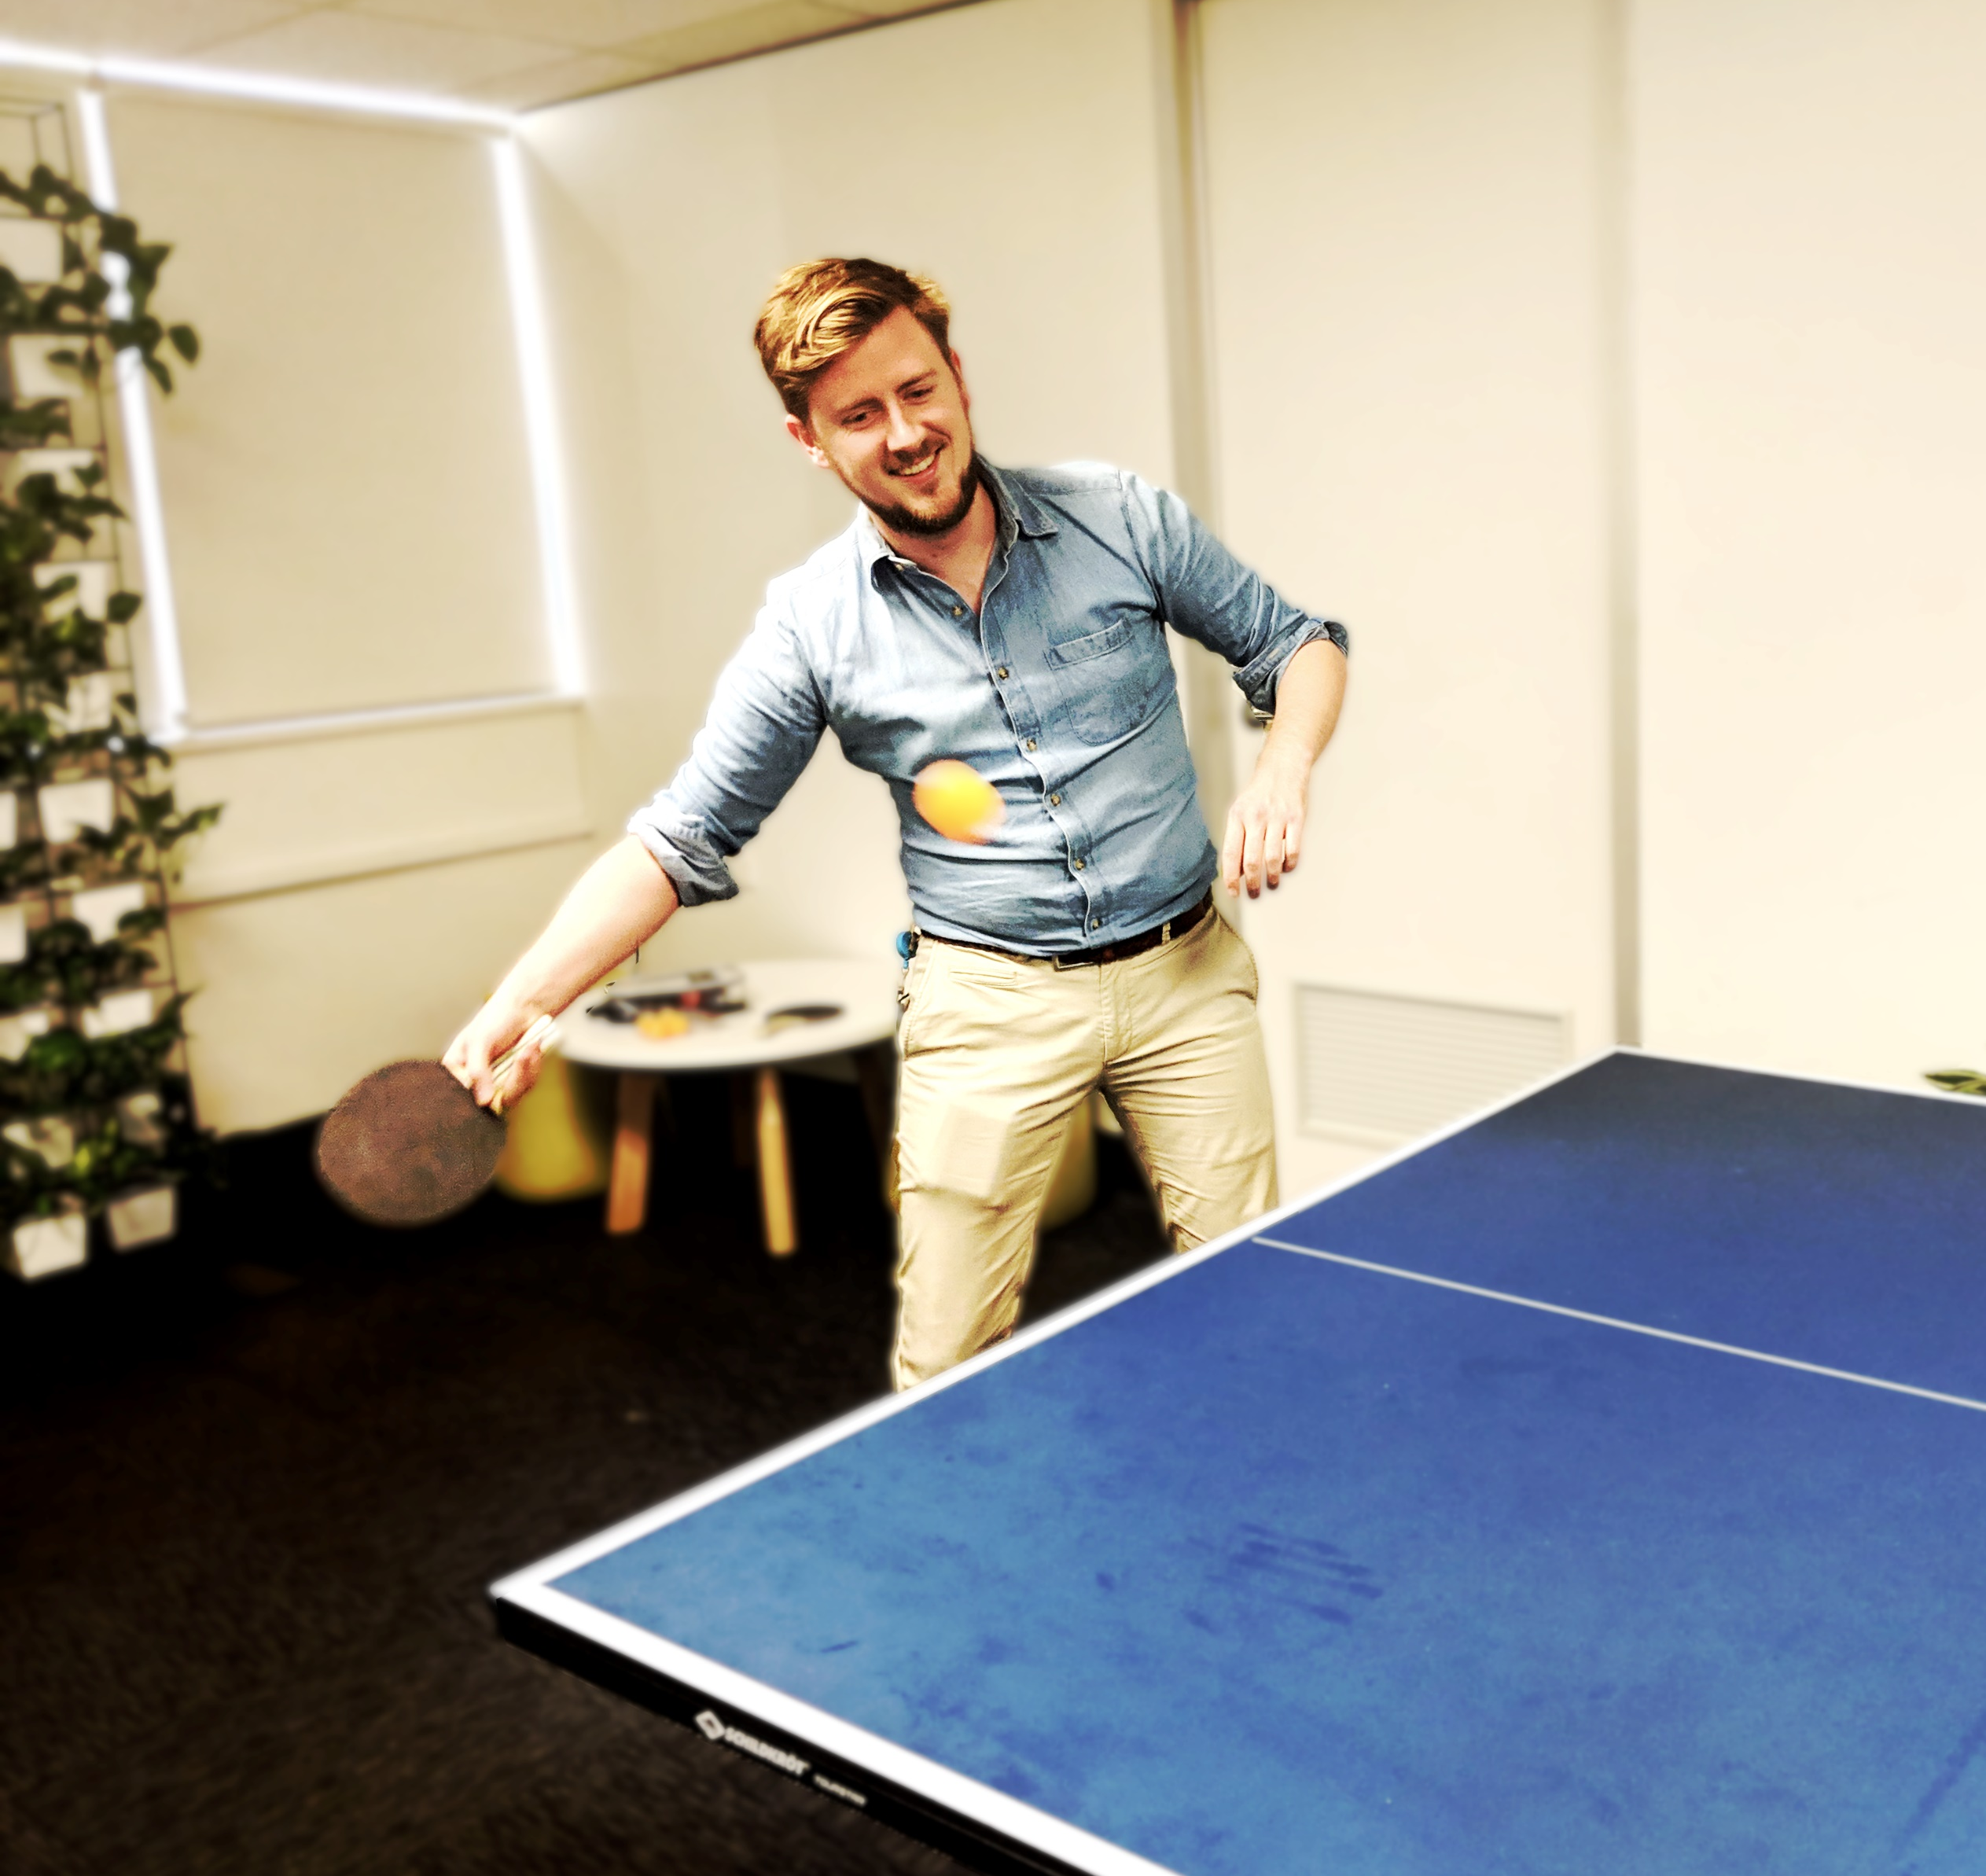
Problems at scale
and what it taught me
Notes:
Hosting a database with 800,000,000 needs more hardware, so start small. I had to work from home one Monday because I started loading records in on Sunday morning and it ran until Monday afternoon. I’m not saying any of you SHOULD do this, I’m just saying that I accidentally did this and got to work in my pyjamas…
No matter how good your code is, big data will break it (even slightly deviant chess games broke my database. Imagine trying to create a Computer vision AI that can deal with photos of documents uploaded to DHS). Every time I scaled up my dataset something new broke.
No matter how well you understand your dataset, big data will surprise you.
Data -> Information -> Knowledge -> Wisdom. I found myself getting better at chess. As I understood the dataset more and more (and created visualisations) I started to get better at finding how the data was related. By the end I could get people to ask questions they’d like to know, and I’d be able to figure it out quickly.
Ping pong

Slide 29
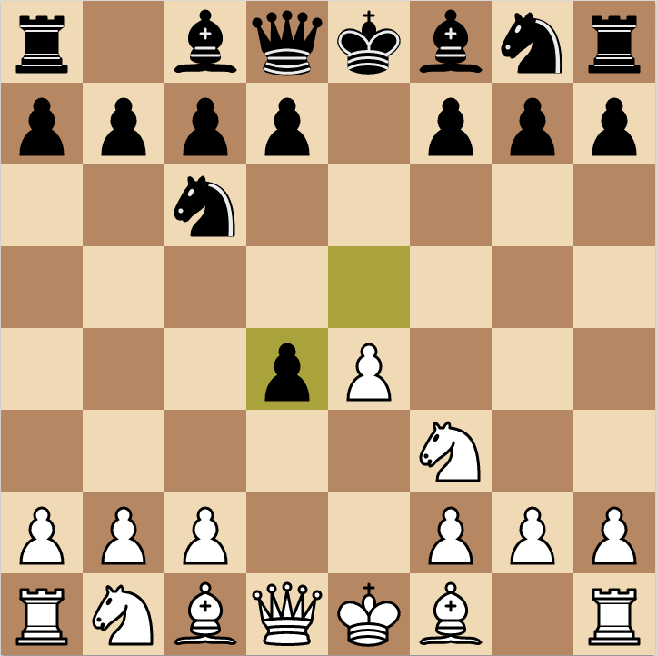
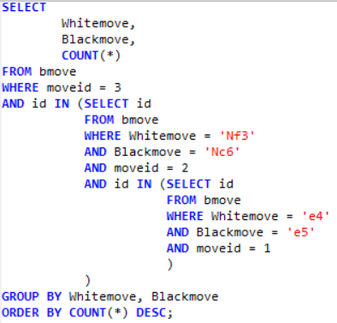
Some preliminary results
Cold…

Slide 30

White wins 51.7% of chess games

Slide 31
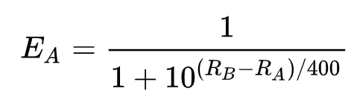
Some more advanced visualisations
…Colder…
Notes:
Explain Elo
Explain that we expect a curve that looks like

Slide 32
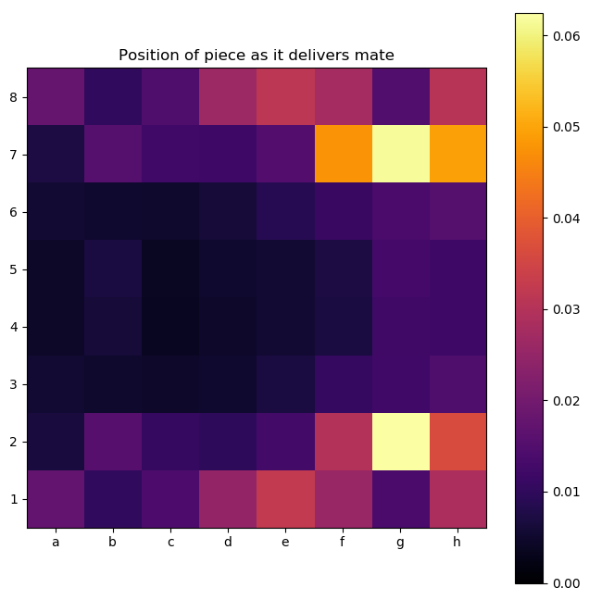
Heatmaps
…getting warmer…

Slide 33
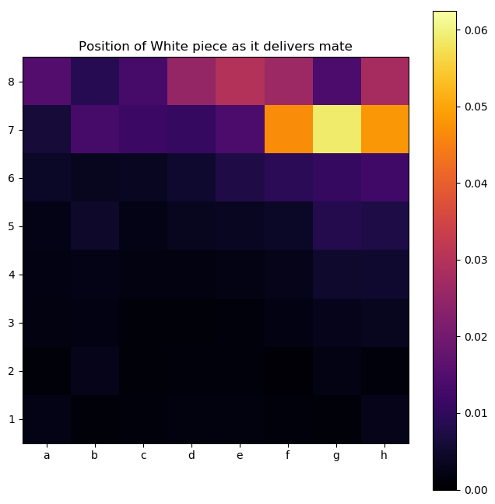
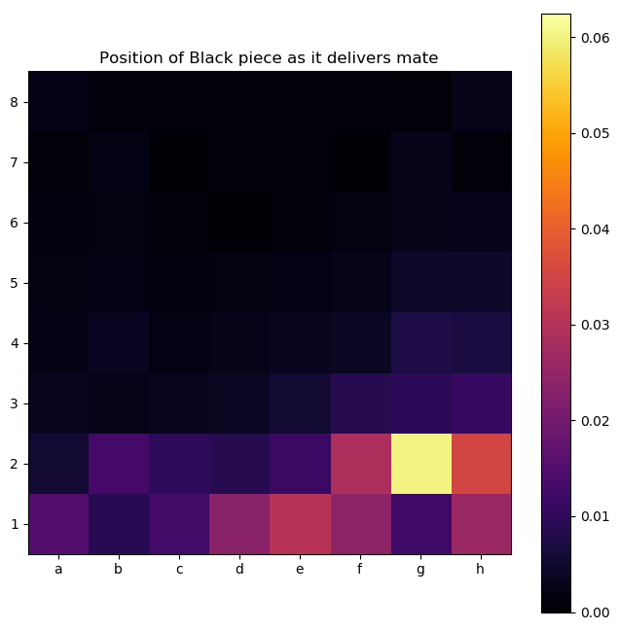
Heatmaps
…getting warmer…

Slide 34
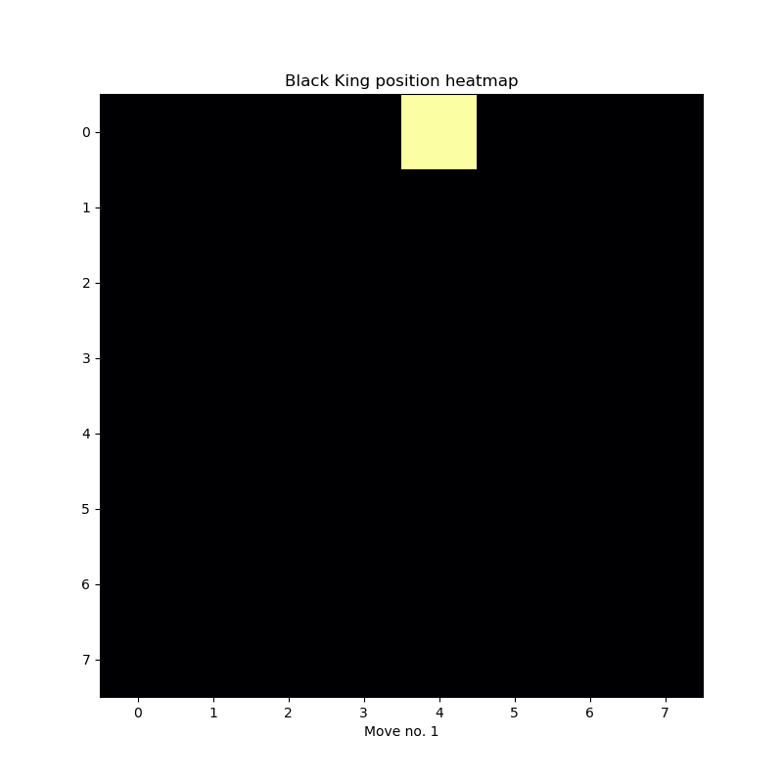
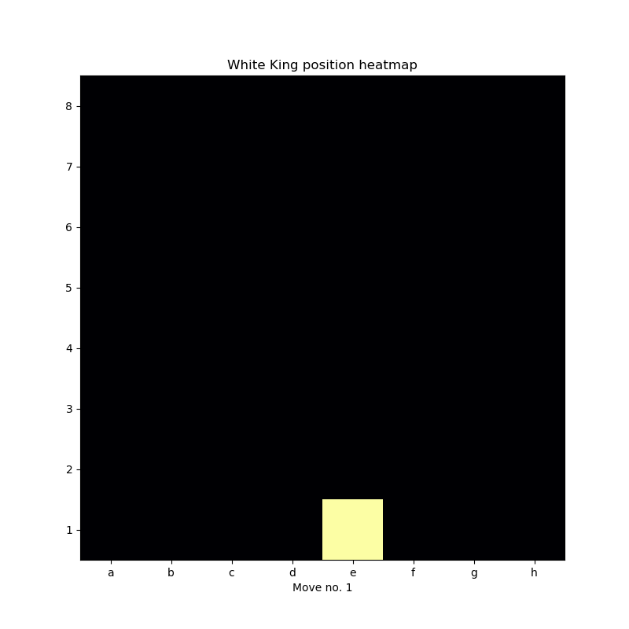
Heatmaps
Hot! Hot! Hot!

Slide 35
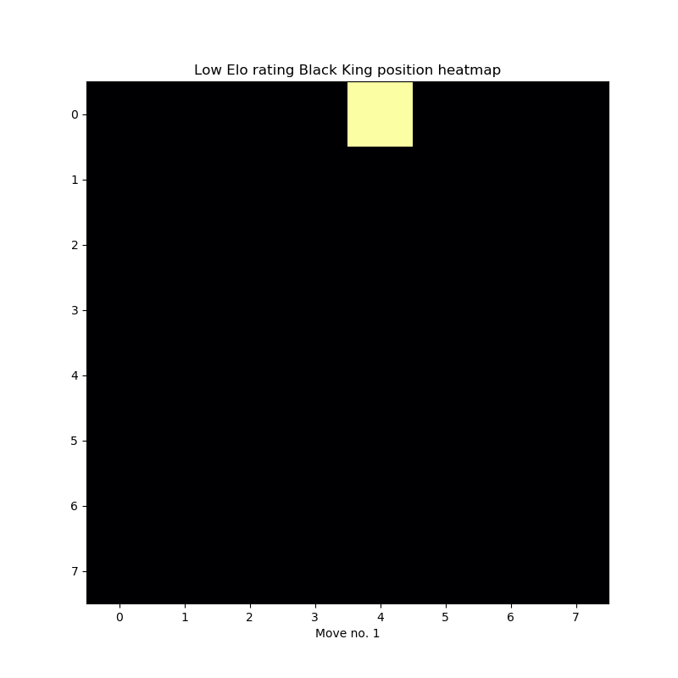

Heatmaps
Hot! Hot! Hot!

Slide 36
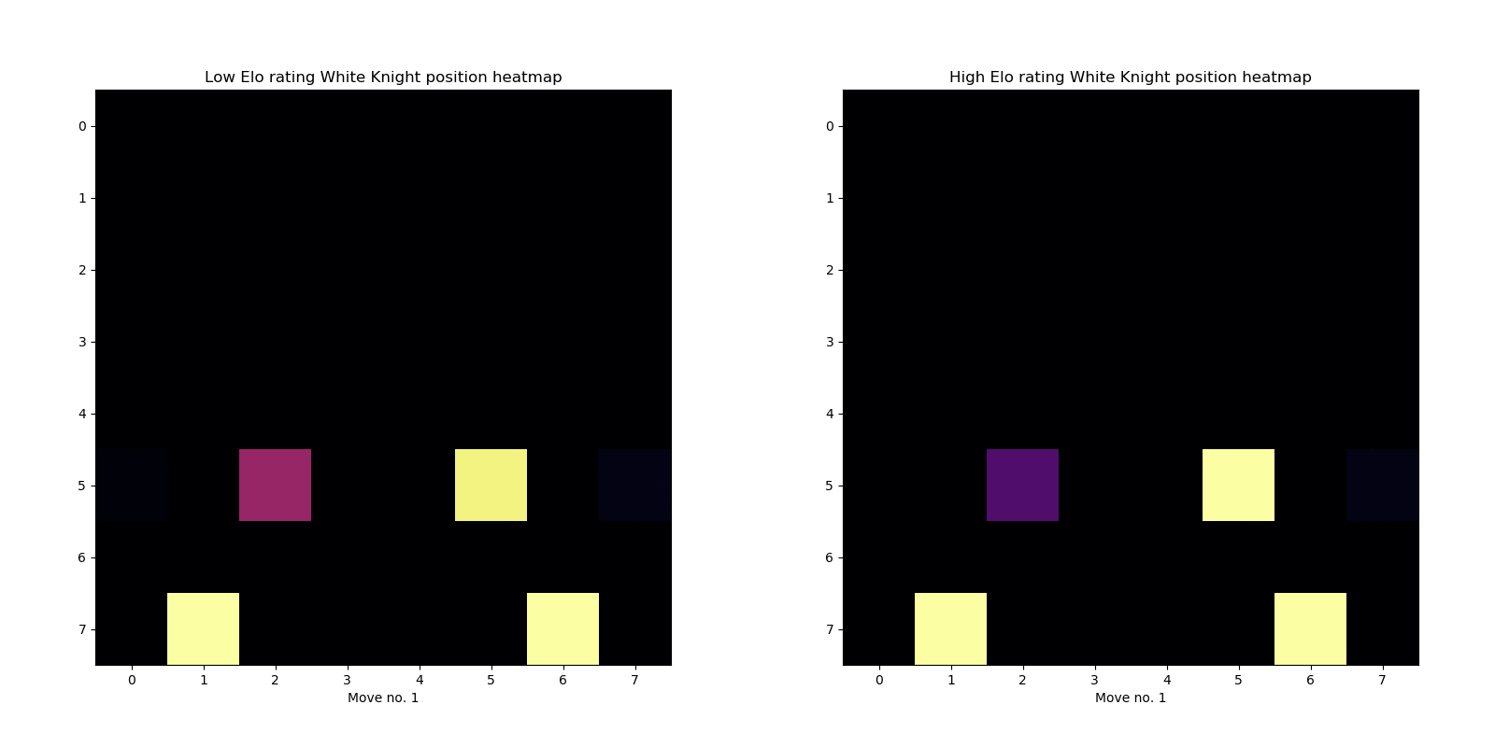
Heatmaps
Hot! Hot! Hot!

Slide 37




Future work
The never-ending project

Slide 38
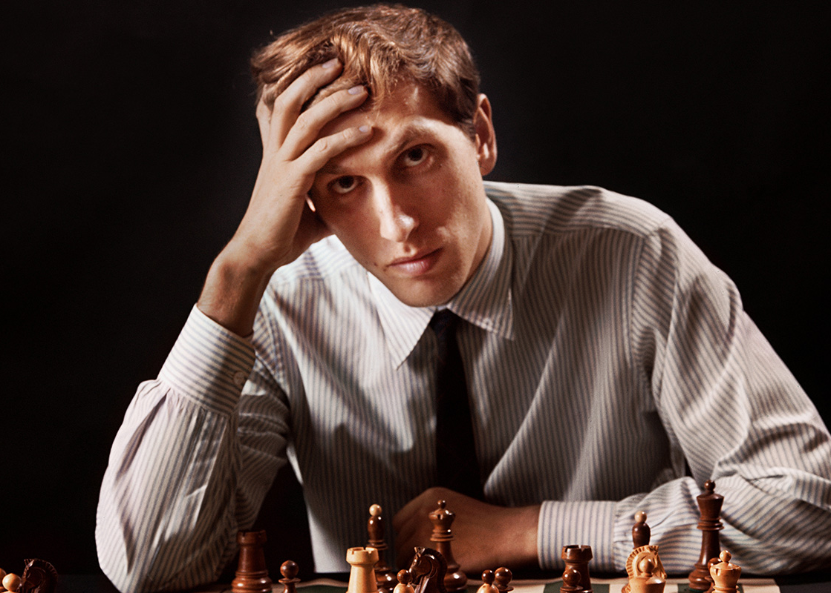
Our mind is all we've got. Not that it won't lead us astray sometimes, but we still have to analyze things out within ourselves.
-- Bobby Fischer
Thank you

